Slide 1
五种时态&语态

Slide 2
补充语法点①辨析 to do& to doing
make efforts to do sth
allow/enable sb to do sth
cause sb to do sth
encourage sb to do sth
require sb to do sth
choose to do sth/prefer to do sth
plan to do/tend to do/fail to do
have a right to do sth
have an obligation to do sth
be willing to do sth
be likely to do sth
不定式；无实际含义；避免双谓语
Be beneficial to doing sth
be detrimental to doing sth
be addicted to doing sth
be indifferent to+n/doing
look forward to doing
be accustomed to doing
adapt to doing sth
be devoted/dedicated to
make significant contributions to doing sth
翻译成“对”、“于”介词+doing
方位；抽象方位

Slide 3
②不定式--非谓语--不是谓语--避免双谓语
不定式做主语--It 做形式主语
To learn English is difficult.=It is difficult to learn English.
通过节食来减肥对于女孩来说是无效的。
It is ineffective for girls to lose weight by dieting.
It is possible for us to achieve Band 7 by working hard.
It is ineffective for parents to improve children’s academic performance by harsh punishment.
It is unrealistic for everyone to be satisfied with their jobs.

Slide 4
非谓语
不定式（to do/ to be done）
（主语/宾语/表语/目的状语/后置定语）
动名词 （doing/being done）
分词（doing/done）

Slide 5
补充语法点 to do/to be done
②不定式--非谓语--不是谓语--避免双谓语
不定式做主语--It 做形式主语
It is effective to improve air quality by decreasing car emissions.
That dogs are loyal friends of human beings is a fact.
It is a fact that dogs are loyal friends of human beings. that+完整句子
It is a common phenomenon that many students choose to travel abroad for fun during summer holidays.

Slide 6
补充语法点 to do/to be done
②不定式--非谓语--不是谓语--避免双谓语
不定式做宾语
I choose to swim during the weekends.
I choose to be educated in America.
Many graduates find it difficult to make a living in the metropolis.
Online shopping makes it possible for modern people to buy ideal products without going out.

Slide 7
补充语法点 to do/to be done
②不定式--非谓语--不是谓语--避免双谓语
不定式做表语
The first step is to pick peaches from trees.
The main responsibility of teachers is to impart knowledge, while that of students is to acquire knowledge and job-related skills.

Slide 8
补充语法点 to do/to be done
②不定式--非谓语--不是谓语--避免双谓语
不定式做目的状语
To achieve a good score, I study day and night.
Many entrepreneurs tend to employ some celebrities to endorse their brands in order to promote the sales.

Slide 9
补充语法点 to do/to be done
②不定式--非谓语--不是谓语--避免双谓语
不定式做后置定语
I have obtained an opportunity to study abroad.

Slide 10
②动名词--名词--doing/being done
动名词做主语
Learning English enables me to deepen my understanding of Western cultures.
Being sent abroad is a good experience for me to learn about a different lifestyle.

Slide 11
②动名词--名词--doing/being done
动名词做宾语 动宾/介宾
I enjoy swimming.
I enjoy being encouraged.
After arriving at the destination, the fish will be frozen.
After being sent to private schools, I begin to learn English well.
Most dolpines object to being touched on the head.
Many migrants in America are against being sent back home.

Slide 12
②动名词--名词--doing/being done
动名词做表语
My hobby is swimming.

Slide 13
③分词--doing/done
分词做后置定语
I like the girl who works in the factory.
I like the girl working in the factory.
The people living in the metropolis are often busy.
The students choosing to study abroad need to learn English.

Slide 14
③分词--doing/done
分词做后置定语
The time which is spent on homework is sufficient.
The time spent on homework is sufficient.
The customers influenced by advertisements often make purchase in advance.
The children spoiled by parents may find it difficult to live independently.
The car park located in the south of the city has been demolished.
The library situated in the centre of the school has been rebuilt.

Slide 15
③分词--doing/done
分词做状语
When I compare those apples, I choose three.
Comparing those apples, I choose three.
Feeling sleepy, I want to order a cup of coffee during the break.
although feeling sleepy, I still try to focus.
Many students are addicted to scrolling short videos, which causes them to lose patience towards everthing.
Many students are addicted to scrolling short videos, causing them to lose patience towards everthing.
Many teenagers are keen to visit museums, allowing them to better know about the history.

Slide 16
③分词--doing/done
分词做状语
When apples are compared with pears, apples are sweeter.
Compared with pears, apples are sweeter.
Influenced by adverstisements, I have bought many things that I do not need.
Encouraged by my parents, I decide to work hard.

Slide 17
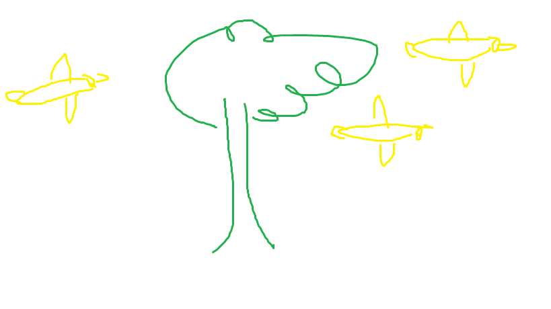
Tree(主干)+Bird（修饰）

Slide 18
Tree(主干)+Bird（修饰）
With the widespread use of electronic devices, the number of people writing letters has seen a dramatic decrease, which reduces the use of paper and promotes a green lifestyle.
Socially active students are often good-looking, which indicates that appearance plays an important role in shaping characters.
With females playing a more important role in the workplace, those who choose to take maternity leave have to face some losses.

Slide 19
③which引导定语从句
A. 我喜欢那本被放在课桌上的故事书。
I like the story book which is placed on the desk.
关系代词；指代book; 翻译成“……的”；修饰一个名词
B. 我有一个苹果，它很甜。
I have an apple, which is sweet.
关系代词；指代apple; 翻译成“它”；指代一个名词
C. 我已经通过了考试，这让我的妈妈很骄傲。
I have passed the exam, which makes my mother proud.
关系代词；指代前面一件事；翻译成“这”；

Slide 20
主 系 表（n/adj/prep/to do）
I am a student.
Socially active students are often incredibly good-looking, which indicates that appearance plays an important role in shaping characters.
Learning English is of great importance.
Many people are in favor of moving large companies from the metropolis to the suburbs, because it can release traffic and housing pressure of the city centre.
Many people are against animal testing because it is morally wrong.
Many people are in favor of space tourism because it is a highly profitable industry.

Slide 21
主 谓 宾
写信的人的数量已经看见了一个大幅度的下降。
The number of people writing letters has seen a dramatic decrease, which reduces the use of paper and promotes a green lifestyle.
Many common diseases have got effective treatments, which makes it possible for modern people to live longer than their grandparents.
Wechat has gradually become one of the most popular applications for teenagers in China.

Slide 22
主 谓 宾
Video games have gradually become one of the most commonly used entertainments for teenagers in China.
The overuse of mobile phones has seriously affected our public life so that some people begin to compare it with smoking.
The increasing violence in movies has seriously affected teenagers’ mental health so that some people suggest that rating system should be adopted to solve this problem.

Slide 23
主 谓
The number of girls writing letters has decreased dramatically.

Slide 24
并列句
and; as well as; or; but; while; whereas; so; and therefore; and then
Physically strong athletes tend to put in a good performance in the sports like weight-lifting and sprint, while mental attitude is a much less important factor.

Slide 25
adv+adj
Socially active students are often incredibly good-looking.
Physically strong athletes tend to put in a good performance.
Many students choose to receive education in academically outstanding universities, which is beneficial to deepening their understanding of other cultures.

Slide 26
adv+adj
Economically successful countries should provide some aid for the needy countries because they cannot solve their own problems.
The government should promote the use of environmentally friendly products and packaging, which is beneficial to reducing garbage and pollution.
Many people are against animal testing because it is morally wrong.

Slide 27
状语从句--状语从句的连词 +句子
原因：because; 结果：so that
Many people are against animal testing because it is morally wrong.
Many people are in favor of space tourism because they believe it is a highly profitable industry.

Slide 28
状语从句--状语从句的连词 +句子
原因：because; 结果：so that
The overuse of mobile phones has seriously affected our public life so that some people begin to compare it with smoking.
The increasing violence in movies has seriously affected teenagers’ mental health so that some people suggest that rating system should be adopted to solve this problem.

Slide 29
介词+n/doing/being done
with+n
随着电子设备的广泛使用
With the wide use of electronic devices,....
随着医疗技术的进步
With the advances of medical technology,....
随着泰勒斯威夫特的流行
With the popularity of Taylor Swift,...
随着油价的上升
With the increase of oil price

Slide 30
with+n+doing/done 随着/有
随着时间的流逝，他已经成为了一个合格的医生。
With time going by, he has become a qualified doctor.
随着很多时间被花在作业上，这里的学生们已经成为了有能力的英语学习者。
With much time spent on homework, students here have become competent English Learners.

Slide 31
with+n+doing/done 随着/有
随着三亚计划发展旅游业，很多酒店已经被建在那里。tourism industry
With Sanya planning to develop tourism industry, many hotels have already been established there.
随着很多消费者被广告影响，他们倾向于去买他们不需要的一些奢侈品。 luxuries
With many consumers affected by advertisements, they tend to buy luxuries which they do not need.

Slide 32
with+n+doing/done 随着/有
随着女性在职场扮演了一个重要的角色，那些选择休产假的女人不得不面对一些损失。losses; take maternity leave; in the workplace
With women playing an important role in the workplace, those who choose to take maternity leave have to face some losses.
随着很多青少年被媒体所操控，他们倾向于掉入商人和政客的圈套。manipulate; media/bacteria/data are...； fall into the trap of
With many teenagers mainpulated by the media, they tend to fall into the trap of businessmen and politicians.

Slide 33
with+n+doing/done 有
很多毕业生发现在大城市找工作很困难，有很多申请者为同一个工作竞争。
Many graduates may find it difficult to secure a job in the metropolis, with so many applicants competing for one position.
这个村庄已经被发展地很好，有很多路被添加在那里。
The village has been developed well, with many roads added there.

Slide 34
五种时态

Slide 35
一般过去时（动态图&静态图）
主动 did | 被动 was/were done
The proportion of girls saw a dramatic increase. | A dramatic increase was seen in the proportion of girls.
The girls wearing white T-shirts accounted for 50% of all girls in 1998.

Slide 36
动态图的常用句型
①介绍句
The line chart illustrates the changes in .....
这个折线图展示了女生和男生的比例的变化在1993到2003年。
The line chart illustrates the changes in the proportion of girls and boys from 1993 to 2002.
这个折线图展示了四种交通方式所运输的货物的量的变化从1992到1998。
The line chart illustrates the changes in the amount of goods transported by four different types of modes between 1992 and 1998.

Slide 37
动态图的常用句型
②句型多样性
The proportion of girls increased dramatically.
The proportion of girls saw a dramatic increase.
There was a dramatic increase in the proportion of girls.
A dramatic increase was seen in the proportion of girls.
The proportion of girls saw an increasing/upward trend in general.
男孩的比例缓慢地下降。

Slide 38
动态图的常用句型
③表示趋势对比--并列句--while/whereas
From 1992 to 1993, a slight decrease was seen in the sales of clothes in America, while those in China increased steadily.
From 1995 to 1996, a dramatic increase was seen in the output of seafood in America, while that in China decreased constantly.

Slide 39
动态图的常用句型
④表示交点--并列句--and
exceed; overtake; surpass （超过）
The sales of children’s book exceeded those of adults’ fiction, and the former had become the best-seller since about 1994.
In 2030, the production of vegetables in America is predicted to exceed that in Brazil, and it will become the largest exporter of vegetables.
In 2050, the proportion of the elderly in China is predicted to excceed that in Japan, and it will become the most serious aging coutry.

Slide 40
动态图的常用句型
⑤表示拐点--并列句--and then
From 1993 to 1994, the time spent on phones per teenager per week firstly saw a temporary decrease, and then it soared to the peak at 21 hours.
Between 1995 and 1996, the money spent on clothes firstly saw a dramatic increase, and then it plunged to the bottom at only 3 million dollars.

Slide 41
动态图的常用句型
⑥表示极值点 the highest point/the peak at +数值
the lowest point/the bottom at+数值
达到最高点 reach the peak at 50%
arrive at the peak at 50%
The proportion of girls soared to the peak at 50%.
The proportion of girls plunged to the bottom at only 10%.

Slide 42
补充：动态图的常用句型
⑦表示差值
My weight increased to 60kg. 上升到
My weight increased by 5kg. 上升了
My weight saw an increasing trend in general, with a jump of 5kg.
The sales of children’s book saw an increasing trend in general, with a jump of 5 million dollars.
The proportion of women often doing exercises saw an increasing trend in general, with a jump of 20%.

Slide 43
动态图的常用句型
⑧在波动中上升
The proportion of girls saw an increasing trend in general, despite some fluctuation in the middle years.
The figure almost remained unchanged over the period, despite several decreases in the middle years.

Slide 44
补充：动态图的常用句型
⑨表示相似趋势
The proportion of girls saw a dramatic increase. Similarly, the figure for boys also grew, but much less significantly, from 2% to only 9%.

Slide 45
动态图的常用句型
⑩动态图中的一般现在时
The chart illustrates......
As is shown in the chart,.....
It is clear/noticeable that.....
It is note-worthy that......
Obviously,......

Slide 46
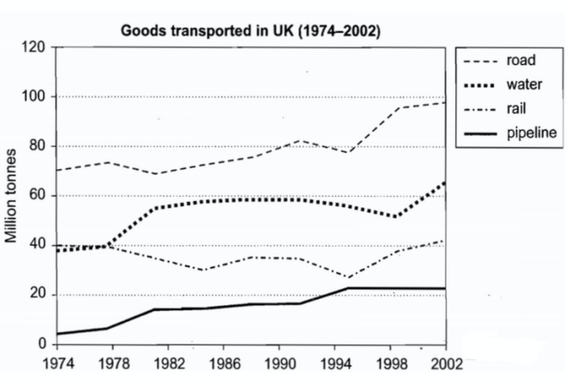
动态图的常用句型

Slide 47
动态图的常用句型
第一段
The graph illustrates the changes in quantities of goods transported in the United Kingdom by four different modes of transport between the time period =between1974 and 2002.

Slide 48
动态图的常用句型
第二段
It is clear that the road remained the most popular method of transporting goods in the UK, while water and pipelines were becoming increasingly used. However, rail had not become more popular as a method of transport.

Slide 49
动态图的常用句型
第三段
As is shown in the graph, road’s quantity of goods was always the largest, and it saw an increasing trend in general despite some fluctuation in the middle years, from 70 to about 100 million tonnes in the end. Smilarly, the figure for pipeline also grew, but much less significantly, from only 5 to 20 million tonnes, making it the least popular mode of transport.

Slide 50
动态图的常用句型
第四段
In terms of water and rail, coincidentally, the figures for them were almost equal in the beginning at about 40 million tonnes. However, the amount of goods transported by water saw a gradual increase, before keeping stable around 60 million tonnes. By contrast, the figure for rail almost remained stable at 40 million tonnes, despite two decreases in the middle years.

Slide 51
静态图的常用句型
①表示占比：account for; occupy; make up; take up; constitute; represent
对象+占有+百分比+of+总数
The girls in white account for 50% of all girls in China.
The girls in white account for 50% of the whole in China.
The proportion of girls in white is 50%.

Slide 52
静态图的常用句型
①表示占比：account for; occupy; make up; take up; constitute; represent
对象+占有+百分比+of+总数
男性吸烟者占了所有男人的30%在中国在1998 年。
Male smokers accounted for 30% of the whole in 1998 in China.
The proportion of men who had a habit of smoking was 30% in 1998 in China.

Slide 53
静态图的常用句型
①表示占比：account for; occupy; make up; take up; constitute; represent
对象+占有+百分比+of+总数
In 1992, the women taking maternity leave accounted for 80% of the whole in America, which was 20% larger than the figure for Brazil.
In 1992, the men taking care of children at home accounted for 10% of the whole in America, which was 2% smaller than the figure for Brazil.

Slide 54
静态图的常用句型
②表示比较级
A is a little/much/twice/three times/20% larger than B
This task is much easier than that one.
This task is much more challeging than that one.
This rope is 5 meters longer than that one.
This book is 5 dollars more expensive than that one.
This room is three times larger than that one.= This room is three times as large as that one
The proportion of boys is 20% larger than that of girls.
The girls in BJ are a little bit taller than those in SH.

Slide 55
③表示最高级
The population of India is the largest.
Chicken was the most popular food for Indian people in 2010.
The apples in China are the most, while those in America are the fewest.
在这五个国家中日本生产了最少的垃圾在2008年。
Japan produced the least garbage among all five countries in 2008.
去日本的游客是最少的。
The Indian tourists going to Japan are the fewest.

Slide 56
④ 非限制性定从--连接
I have an apple, which is sweet.
I have three apples, two of which are sweet.
There are many apples, a half of which are green.
I have an aunt, who is beautiful.
I have three aunts, two of whom are beautiful.
There are many Indian tourists, 30% of whom choose to go to America.

Slide 57
⑤往往按照大小的逻辑去写
Over-grazing was the main reason leading to land degradation, accounting for 30%.
This was followed by deforestation and over-cultivation, occupying 28% and 20% respectively.

Slide 58
⑥避免流水账--先写特征，再写细节
Coal was the main source in China in 1995, contributing 50% of electricity.
Over-grazing was the main reason for land degradation, accounting for 35% of the whole.

Slide 59
⑦用过去完成时--表示强烈对比
The production of electricity by coal saw a dramatic increase from 5 units to 50 units. 平淡的表达
In 1980, the production of electricity by coal was only 5 units, while by 2000, it had soared to 50 units. 强烈的表达

Slide 60
⑤往往按照大小的逻辑去写
Over-grazing was the main reason leading to land degradation, accounting for 30%.
This was followed by deforestation and over-cultivation, occupying 28% and 20% respectively.

Slide 61
一般现在时
主动 do/does/should do | 被动 be done
I often do my homework after lunch. | I am educated in China.
She often does her homework before lunch. | She is educated in America.
They should do their homework. | We are educated together.
 | They should be educated.
 | am/is/are done&should be done
 | 流程图（will be done）

Slide 62
一般现在时-大作文-第三人称单数
She/he/it
China
Doing Homework
What I eat
..., which makes
是I吗？是You吗？是复数吗？
都不是---后面动词+s

Slide 63
流程图的常用句型
①The flow chart illustrates how the glass bottles are recycled, which can be divided into three main stages including collecting, processing and selling respectively.
这个流程图展示了桃子罐头是如何被制作的。
The flow chart illustrates how peach cans are produced, which can be divided into three main stages including picking, processing and selling respectively.
这个流程图展示了巧克力是如何被制作的。
The flow chart illustrates how chocolate is produced, which can be divided into three main stages including preparing raw materials, processing and selling respectively.

Slide 64
②【然后】的多样性
介词after
After arriving at the destination, the fish will be frozen.
After being transported to the port, the fish will be frozen.
介词before
I prefer to have dinner first before watching movies.
Apples are washed before being eaten.
并列连词 and then +完整句子（主语可以省略）
The fish are cleaned at first, and then they will be frozen.
非限制性定从 after which+完整句子
The fish are cleaned at first, after which they will be frozen.

Slide 65
流程图的常用句型
条件状语从句 Once XXX，XXX will XXX
Once washing is finished, the fish will be frozen.
时间状语从句 XXXXX, until XXXX
The pieces will be heated until they are completely melted into liquid.
副词 Subsequently
The fish are cleaned at first. Subsequently, they will be frozen.
介词短语 After that
The fish are cleaned. After that, they will be frozen.

Slide 66
流程图的常用句型
③地点名词+where+完整句子
Finally, those products will be delivered to the supermarket where they will be sold to various customers.

Slide 67
流程图的常用句型
④不能用祈使句
Open the door. ×
The door should be opened at first. √

Slide 68
练习
在到达目的地之后，鱼会被放在冰箱当中，在那里他们会被冻住。
After arriving at the destination, the fish will be put into the fridge where they will be frozen.
一旦清洗被完成，干净的瓶子会被分成三组根据他们的颜色。
Once washing has been finished, the clean bottles will be divided into three groups according to their colors.
在被抓之后，鱼会被运输到港口，在那里被冻住。
After being caught, the fish will be delivered to the port where they will be frozen.

Slide 69
before; after; until; once; where; after which
2. 使用过的玻璃瓶先被收集在回收站，然后运输到工厂，在那里被清洗。
After being collected at the recycling station, the used glass bottles are transported
to the factory where they are washed.
3. 桃子被从树上摘下来，然后被装（put）在一个特殊的容器，在那里他们被清洗。
4. 一旦完全解冻，鱼会被切成两半，然后浸泡在有染料的水中，直到变成黄色。
Once defrosting is finished, the fish will be cut in half, after which they are
soaked in the water full of coloring until becoming yellow.

Slide 70
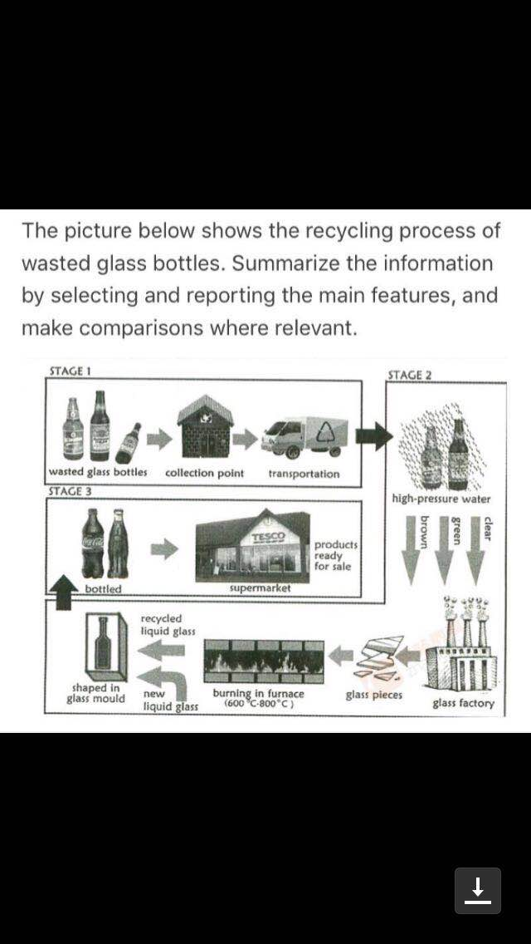
一般现在时-流程图
制作工艺--被动语态：be done(transitive)

Slide 71
现在完成时--动作发生在过去，强调对现在的影响
主动 have/has done | 被动 have/has been done
I have watched the film before. | The car park has been established in the south of the community.
She has lived in BJ for three years. | The gate has been demolished .
 | 地图（过去+现在）

Slide 72
地图题的常用句型
① The two maps compare how the village has been rebuilt in the past thirty years.
这两个地图对比了花园是如何被发展的自从1995年以来。
The two maps compare how the garden has been developed since 1995.

Slide 73
地图题的常用句型
②位于 A be located in/on/to the south of B.
A be situated in/on/to the south of B.
A lie in/on/to the south of B.
曾经位于村庄南部的停车场已经被拆掉了。
The car park which was located in the south of the village has been demolished.
The car park located in the south of the village has been demolished.

Slide 74
地图题的常用句型
②位于 A be located in/on/to the south of B.
A be situated in/on/to the south of B.
A lie in/on/to the south of B.
曾经位于村庄南部的停车场已经被拆掉了。
The car park which lay in the south of the village has been demolished.
The car park lying in the south of the village has been demolished.

Slide 75
地图题的常用句型
②位于 A be located in/on/to the south of B.
A be situated in/on/to the south of B.
A lie in/on/to the south of B.
位于城市中心的超市已经被大大地扩建了。
The supermarket located in the city center has been expanded dramatically.
I am educated in China.
The supermarket lying in the city center has been expanded dramatically.

Slide 76
地图题的常用句型
③并列句表示转折 while/whereas
There used to be a car park in the south, while now it has been demolished.
There has been a new car park in the south, while the previous hotel was demolished.
Many new facilities have been added in this park, while the green landscapes have been decreased.

Slide 77
地图题的常用句型
④ With+n+doing/done
Many changes have taken place in the south, with a new car park built next to the hotel.
The housing area has been expanded dramatically, with two branches of roads added there.

Slide 78
地图题的常用句型
⑤ XXXXX，to the east of which XXXX
I have a house, to the south of which there is a supermarket.

Slide 79
地图题的常用句型
⑥ There is a C now where D once stood. (C 替代了D)
There is a C now where D used to be.
There is a C now where D previously was.
曾经是停车场，现在是餐馆在城市南部。
There is a new restaurant now in the south of the city where the old car park once stood.
曾经是操场，现在是图书馆在学校东北角
Where the old playground once stood, there is a new library now in the northeastern corner of the shcool.

Slide 80
地图题的常用句型
⑦无变化的表达方式
XX is the only part that remains unchanged.
XX and XX are the two only parts that remain unchanged.

Slide 81
地图题的常用句型
⑦逻辑为王
Many changes have taken place in this area. A significant one is that.....; Another important one is that.....
Further to the south,.....

Slide 82
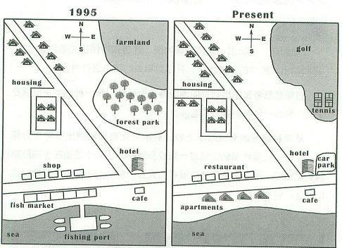
现在完成时（地图）

Slide 83
过去完成时--动作发生在过去的过去，强调对过去某一时间的影响
主动 had done | 被动 had been done
I had watched the film before 2003. | The village had been rebuilt since 1995 until 2005
饼图（过去+过去） | 地图（过去+过去）
The proportion of the spending on food in America had plunged to 20% by 2013.

Slide 84
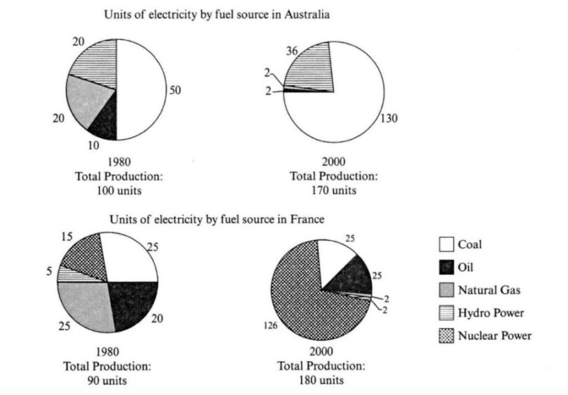

Slide 85
The production of electricity by coal saw a dramatic increase from 50 units in 1980 to 130 units in 2000.
In 1980, the production of electricity by coal was 50 units. However, by 2000, it had soared to 130 units, accounting for three quarters of the whole.

Slide 86
一般将来时
主动 will do | 被动 will be done
I will become a scientist in the future. | The village is predicted to be rebuilt in the future.
be expected to | 地图（现在+将来）
be indicated to | 预计会
be predicted to | be expected to/be indicated to/be predicted to
The proportion of girls is predicted to see a dramatic increase.

Slide 87
